Slide 1
סיפור של התקפה
Tzachi Zorenstein - Cyber Security Architect

Slide 2
מטרת ההרצאה
I will try to do a constrictive educational talk ( No more cyber FUD please ☺ ) .
I will try to give some examples of a new approach dealing with APT (this is a short lecture, feel free to ask me later for more details)

Slide 3
Shamoon \ W32.Disttrack
On 15 Aug Saudi Arabia's national oil company said an attack had led to its own network being taken offline
Reports start streaming in the next day analyzing the malware attempt
The attack is called "Shamoon", due to a string of a folder name within the malware executable ("C:\Shamoon\ArabianGulf\wiper\release\wiper.pdb")
Shamoon consists of several components:
Dropper—the main component and source of the original infection. It drops a number of other modules
Wiper—this module is responsible for the destructive functionality of the threat
Reporter—this module is responsible for reporting infection information back to the attacker

Slide 4
Dropper Component
The Dropper component performs the following actions:
Copies itself to %System%\trksvr.exe
Drops the following files embedded into resources:
  A 64-bit version of the dropper component: %System%\trksrv.exe (contained in the “X509” resource)
  Reporter component: %System%\netinit.exe (contained in the "PKCS7" resource)
  Wiper component: %System%\[NAME SELECTED FROM LIST].exe (contained in the "PKCS12" resource)

Slide 5
Copies itself to the following network shares:
  ADMIN$
  C$\\WINDOWS
  D$\\WINDOWS
  E$\\WINDOWS
Creates a task to execute itself
Creates the following service to start itself whenever Windows starts:
  Service name: TrkSvr
  Display name: Distributed Link Tracking Server
  Image path: %System%\trksvr.exe

Slide 6
Wiper Component
The Wiper component includes the following functionality:
Deletes an existing driver from the following location and overwrites it with another legitimate driver:
  %System%\drivers\drdisk.sys
  The device driver is a clean disk driver that enables user-mode applications to read and write to disk sectors. The driver is used to overwrite the computer’s MBR but may be used for legitimate purposes.
  The file is digitally signed

Slide 7
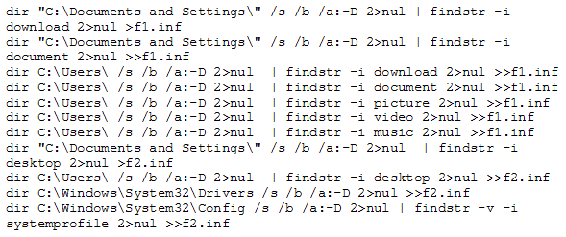
Executes the following commands that collect file names, which will be overwritten and writes them to f1.infand f2.inf:

Slide 8

Files from the f1.inf and f2.inf will be overwritten with the JPEG image shown below. Overwritten files are thus rendered useless.

Slide 9
Reporter Component
The Reporter component is responsible for sending infection information back to the attacker. Information is sent as a HTTP GET request and is structured as follows:
http://[DOMAIN]/ajax_modal/modal/data.asp?mydata=[MYDATA]&uid=[UID]&state=[STATE]
The following data is sent to the attacker:
[DOMAIN]—a domain name
[MYDATA]—a number that specifies how many files were overwritten
[UID]—the IP address of the compromised computer
[STATE]—a random number

Slide 10
The Shamoon Attacks Continue
A couple of weeks later RASGAS which is a liquefied natural gas (LNG) producing company in Qatar been attacked as well (It is the second-biggest LNG producer in the world)
This time it was a new variant , that wipes files by overwriting them using 192 KB blocks of randomly generated data, compared to the previous version that used a 192 KB blocks filled with a partial JPEG image of a burning United States flag

Slide 11
Shamoon Lesson Learned ???
Defense Secretary Leon E. Panetta warned that the United States was facing the possibility of a “cyber-Pearl Harbor” and was increasingly vulnerable to foreign computer hackers who could dismantle the nation’s power grid, transportation system, financial networks and government

Slide 12
Is This a One Time Event ?
בכלל בשבועות האחרונים ישנה עליה משמעותית במספר אירועי האבטחה:
10 ינואר : פירצת Zero Day חדשה בJAVA שמנוצלת כנגד
מספר רב של תחנות
13 בינואר : Oracleמשחררת תיקון חירום
14 ינואר : Microsoftמשחררת תיקון חירום ל IE לפירצת Zero day
ששימשה להתקפות ממוקדת
16 ינואר : Oracleמשחררת עידכון מסיבי למוצרים שלה שכולל 86 פגיעויות
18 ינואר : מתגלה מבצע Red October שיועד לפגוע במספר רב של
סוכניות ממשלתיות

Slide 13
31 לינואר : התקפה על NY Times ומערכות עיתונים נוספות
1 לפברואר : Oracleמודיעה על עוד מקבץ תיקונים ומשחררת עוד תיקון
ל- 50 פגיעויות נוספות
2 לפברואר : Twitter מודיעה על פירצה אליה שסיכנה כ 250,000 חשבונות
7 לפברואר : Adobe משחררת תיקון חירום כנגד פירצות Zero Day שהתגלו בהתקפות על לקוחות
12 לפברואר : Adobe משחררת תיקון כנגד 17 פגיעויות נוספות
ועוד 2 ב Shockwave Player
12 לפברואר : Microsoft משחררת עידכון מסיבי כנגד 57 פגיעויות
13 לפברואר : פירצתZero Day כנגד Adobe Acrobatחדשה מתגלת אצל
לקוחות המכילה אלמנטים שלא נראו בעבר (קישור)

Slide 14
27 לפברואר : Adobe משחררת תיקון חירום
5 למרץ : Oracle משחררת תיקון חירום ל-Java
(התקפות על Facebook, Apple ועוד)
לאחרונה, ארגון Mitre (האירגון שאחראי על מירשםCVE שהינו הכלי הסטנדרטי לרישום פגיעויות ) הודיע שפורמט הCVE יעבור הרחבה מכיוון שהיום הוא תומך רק ב 9999 פגיעויות בשנה (ב 2012 ראינו 5,289 פגיעויות), Mitre סבורים שהם יחרוג מהמכסה הקיימת בעתיד הקרוב

Slide 15
גם הפוגענים נהיו יותר "מגניבים " :
קוד התקיפה נכתב עם ROP לעקוף את ההגנות של מערכת ההפעלה , יש שימוש בפגיעות שנייה על מנת להיתחמק מהסביבה המאובטחת (Sandbox ) של Adobe , ישנו שימוש רב בטכניקות שמונעות ניתוח של הקוד כגון TLS callback(טכניקה היכולה לשמש להריץ קוד על המחשב של חוקר הוירוס ☺ ) כתיבת 200 רשומות מזויפות ב Export Table ועוד
שימוש בציוצים של חשבונות נבחרים ב-Twitter . הפוגען מחפש ציוצים שמכילים את הקוד Uri! ודרכם ייגש לשרתים רלוונטים. יתרה על כך התוקף יישם מנגנון נוסף במידה שTwitter לא יהיה זמין , הפוגען יבצע חיפוש של מחרוזת תווים ייעודית בגוגל ובמידה ויהיה תוצאות יתחבר אליהם השרת שמחזיר תוצאה הוא שרת השליטה החדש ( עכשיו אני מניח שתוקפים צריכים ללמוד קידום אתרים באינטרנט כיכולת נדרשת נוספת ☺ )

Slide 16
Typical Threat Attack Steps
I. Get inside with social engineering
III. Infiltrate key resources
IV. Persist and propagate
V. Accomplish exfiltration objectives
(e.g. data harvesting, sabotage, etc.)
II. Establish a beachhead
Notes:
Malware attacks generally occur in stages over time. NTR can identify trends before an attack is fully deployed.

Slide 17
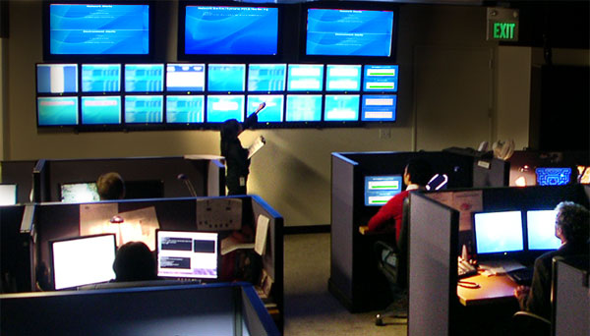
Monitoring and Response Challenges
Too Much of the Wrong Data
  Most SOC collect a lot of data and events without real uses
  Legacy IDS and IPS are misplaced and produce non-actionable events as a result
  Critical content visibility and contextual understanding is missing
  Attack payloads are obfuscated at the perimeter and easily changed
Non-Enterprise approach to response
  Many government agencies operate independently with different controls, capability and priorities
  Centralized detection relies on traditional reporting which does not scale
  Agencies lack capability or will to do effective monitoring
Notes:
NTRs focus is on identifying threats within the network and pushing actionable data to the network security analyst

Slide 18
Speed Equals Capacity
Performance
Static
Quickest (Product Dependent)
Little Normalization
Emulation
Good Speed (60 milliseconds)
Excellent Normalization
Dynamic Analysis
Extremely Slow (Min 500 Sec/Samples)
Best Normalization
Good
Fair
Poor
Notes:
Static analysis is geared towards speed, however it produces imperfect threat events often generating false positives. OOS uses static analysis for object down select.
Emulation ascertains the objects behavior in a sandbox. Emulation produces reasonable object behavioral descriptions but its environment can be detected by a virus. A layered, object oriented security (OOS) approach uses all three detection mechanisms. Static analysis is used for down select. Emulation and Dynamic Analysis are used for down selected object analysis and deconstruction.

Slide 19
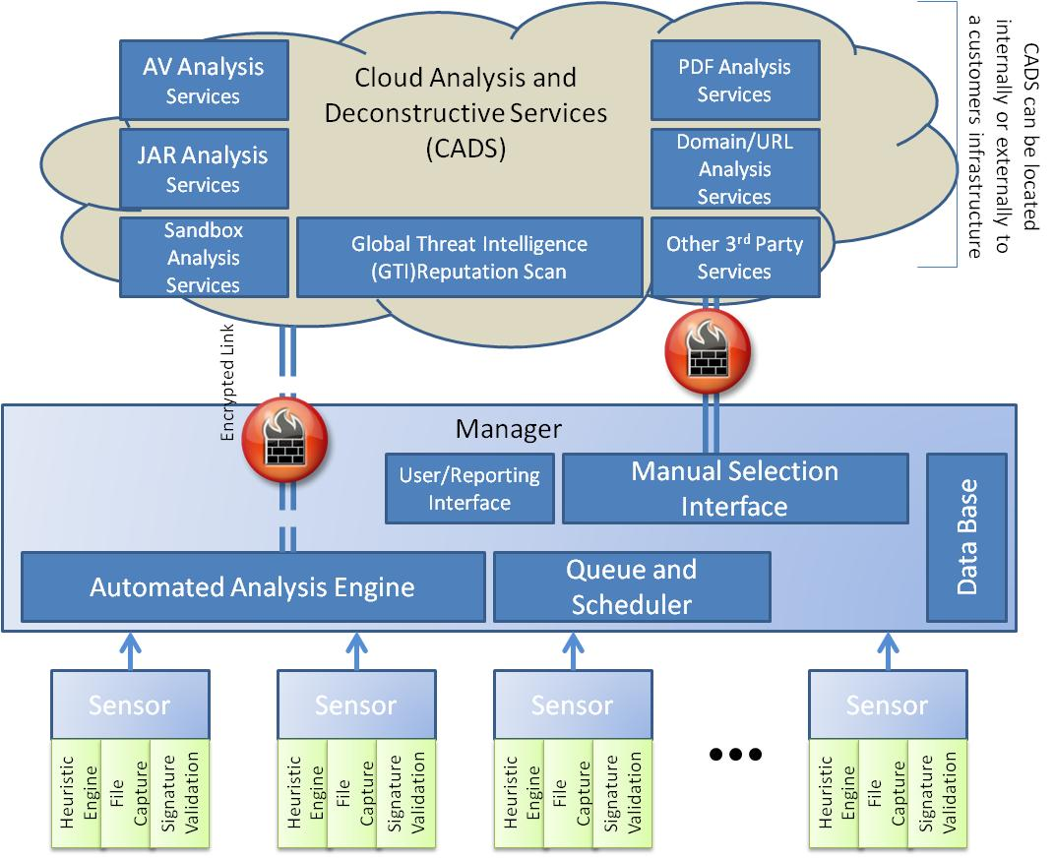
NTR: Intelligence-Driven Response Solutions
    Detection services deployed on customer network and host for best coverage
    Validation services deployed at customer SOC or Cloud provider
    Decision framework provides impact assessment and integration to other systems
    Integrated intelligence
      McAfee Global Intelligence used as both a validation and response service
      Local Intelligence collected from historical data
Notes:
As the threat evolves, new threat analysis solutions are be deployed on the Cloud without impacting customer’s infrastructure.
NTR seeks to leverage “best-of-breed” solutions, not a one size fits all.
This three tiered architecture is how NTR accomplishes detection using static, emulation, and dynamic analysis.

Slide 20










McAfee NTR Architecture : Sensor
NTR
Sensor
Cloud Analysis and Deconstructive
Services
NTR
Manager
Internet
Local
Sensors
NTR Sensors are deployed in at the boundaries and exchanges of the network

Slide 21

McAfee NTR Architecture : Manager
NTR
Sensor
Cloud Analysis and Deconstructive
Services
NTR
Manager
Internet
Manager
Collects data from the sensors and matches analysis to services

Slide 22
McAfee NTR Architecture : CADS
NTR
Sensor
Cloud Analysis and Deconstructive
Services
NTR
Manager
Internet
AntiVirus
Scans
McAfee
Global Threat Intelligence Database
McAfee
& 3rd Parties
McAfee
FileScan
SandBox
Emulation
3rd Party
Manager
Collects data from the sensors and matches analysis to services

Slide 23






McAfee NTR Overview
Leverage local intelligence capability of major integrators and SOC providers for resilient
threat detection
McAfee Global Threat Intelligence reputation combined used by NTR for rapid attack validation
NTR Cloud
Analysis and Deconstruction Service
Signatures
NTR File Scan
Sandboxes
Analysis
Regional and Local Threat Intelligence
Global Threat Intelligence
RESTful
service over HTTPS
Reputations:
URL, File, IP, etc
SSL protected communication
SOC Analysts
Remote on premise NTR sensor deployed on a tap or off span port of the McAfee IPS.
NTR Manager
Remote on premise or in Telco network NTR sensor deployed on Cloudshield platform.
Objects down-selected for further analysis securely sent to NTR manager.
Notes:
NTR is eminently expandable without major impacts on deployed infrastructure.

Slide 24
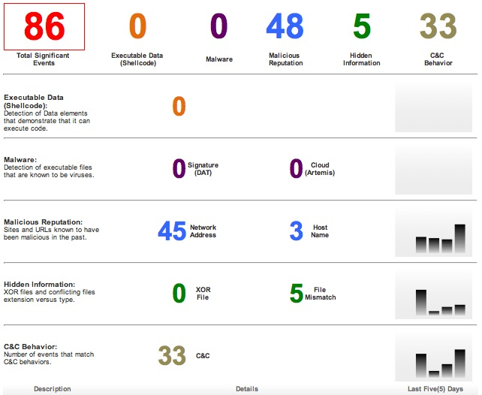
McAfee NTR: Main Dashboard View
Notes:
The NTR Analyst interface provides a simple, yet complete extraction of information. Additional information on a threat is exposed by drilling into the event type.

Slide 25
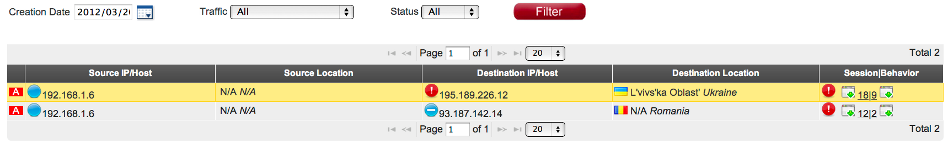
McAfee NTR: File Mismatch View

Slide 26
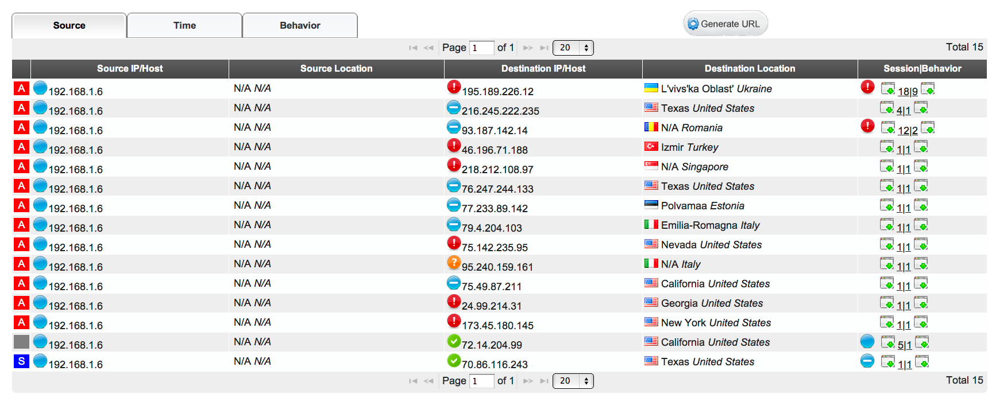
McAfee NTR: IP Behavior View

Slide 27
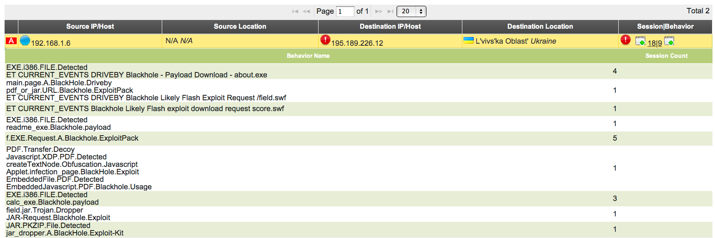
McAfee NTR: File Behavior View

Slide 28
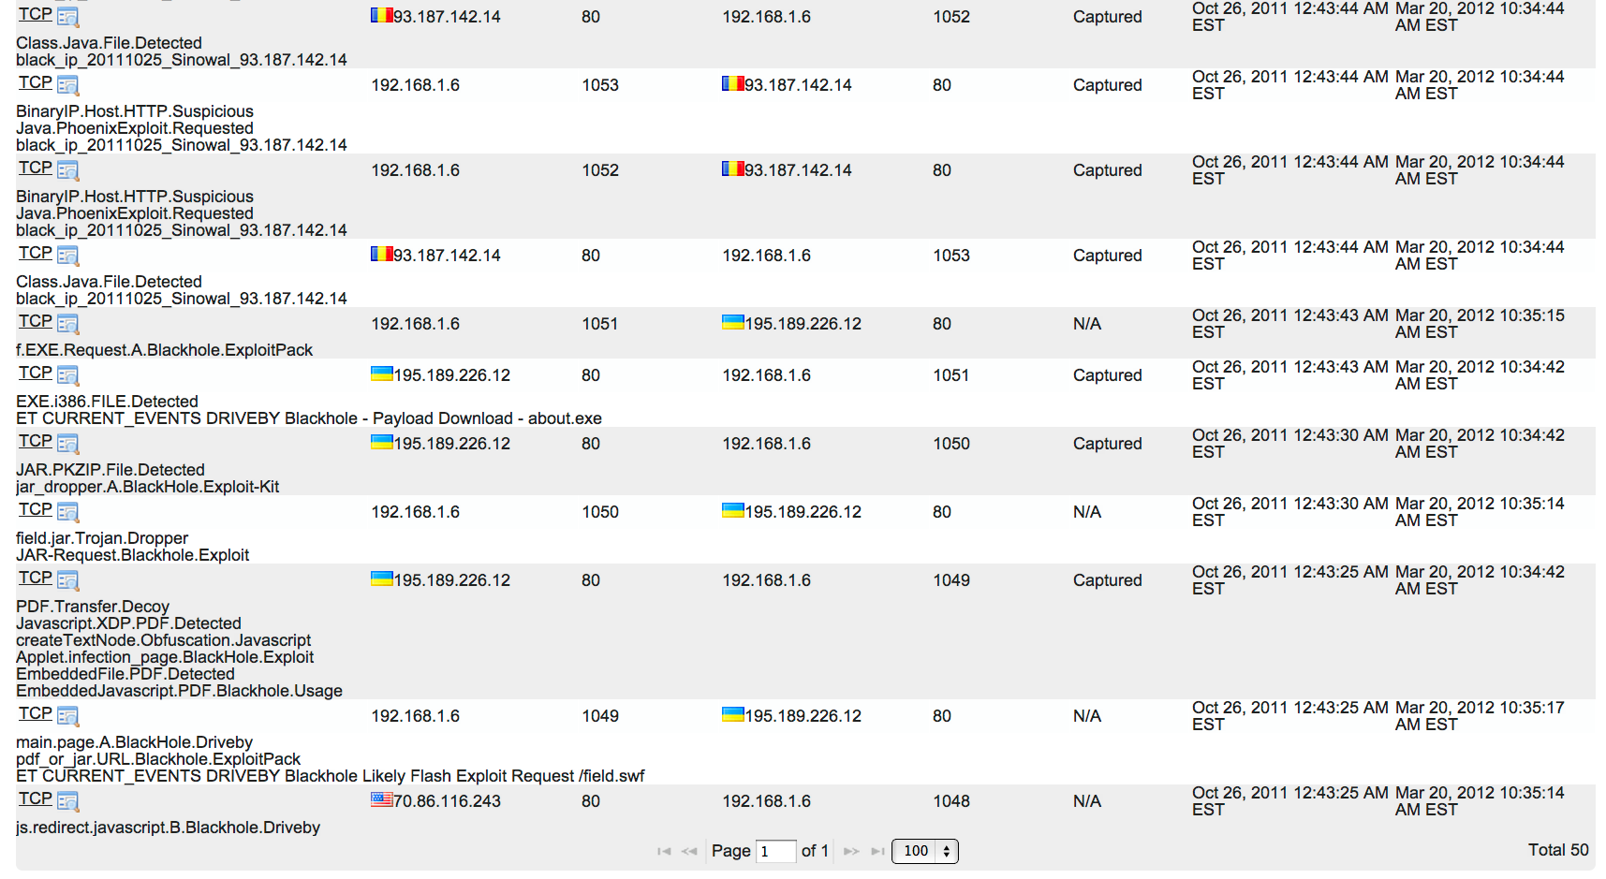
McAfee NTR: Time Sort View

Slide 29
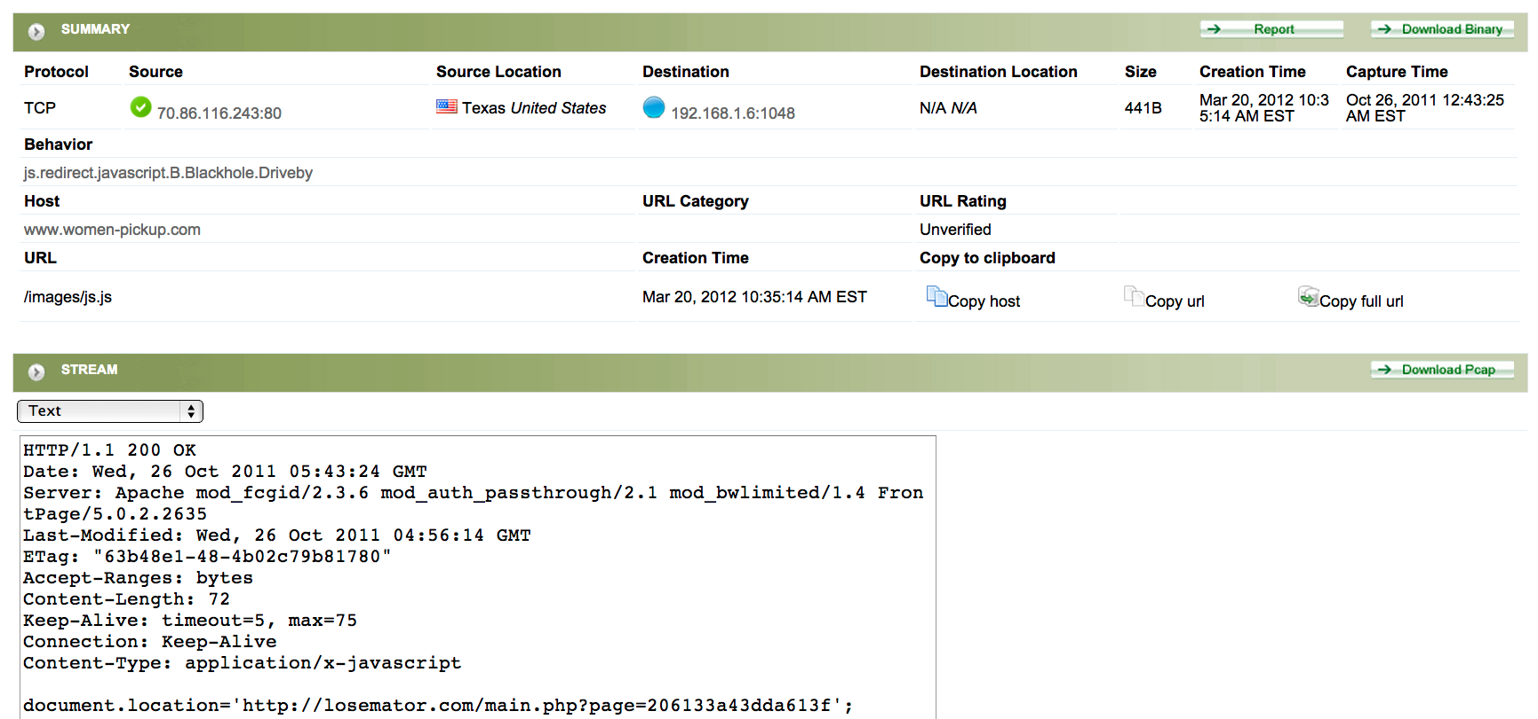
McAfee NTR: First Alert Landing View

Slide 30
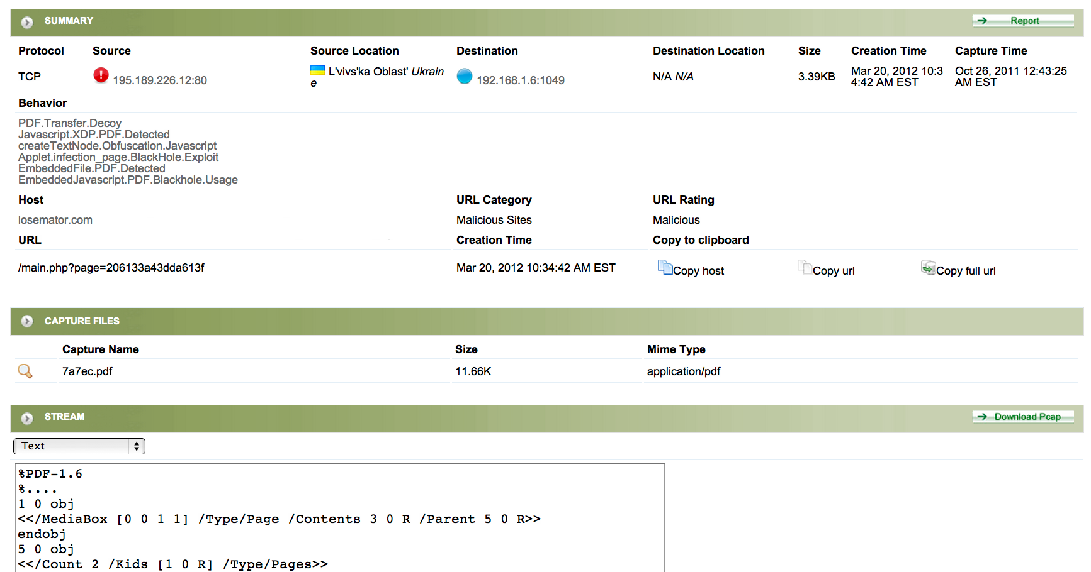
McAfee NTR: PDF Alert View

Slide 31
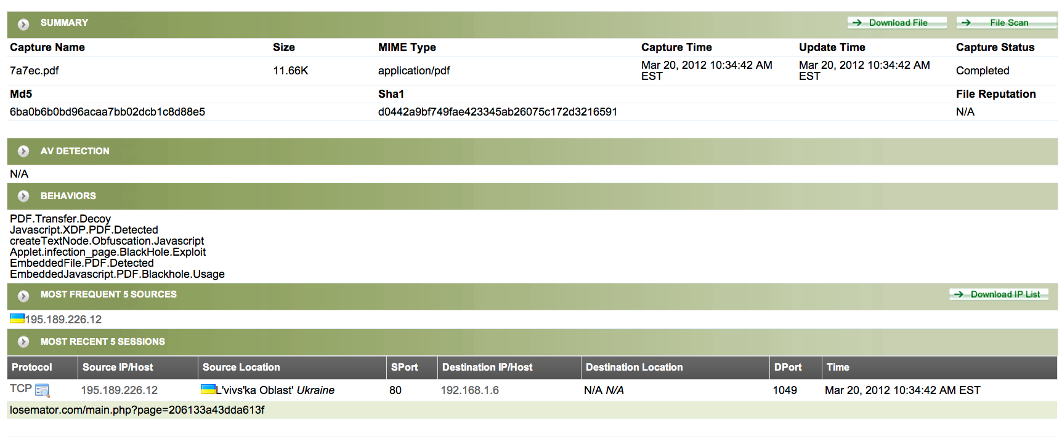
McAfee NTR: Behavior View

Slide 32
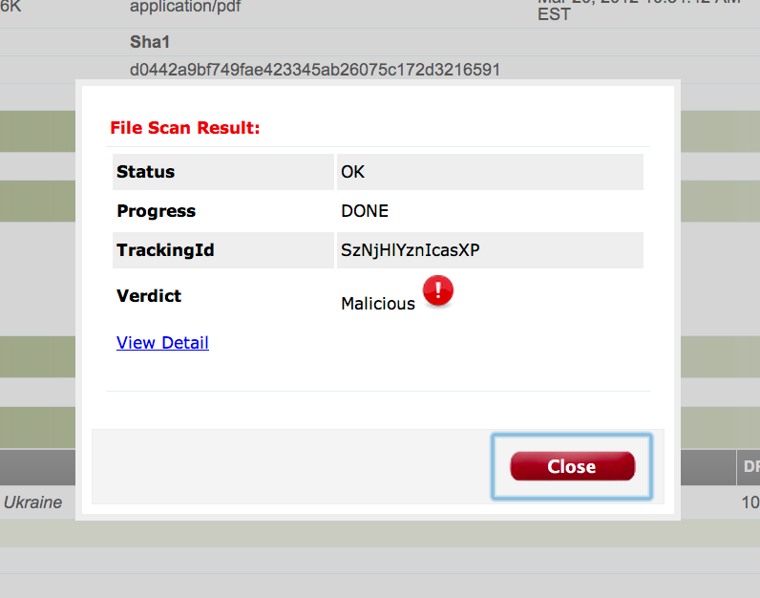
McAfee NTR: File Scan Result View

Slide 33
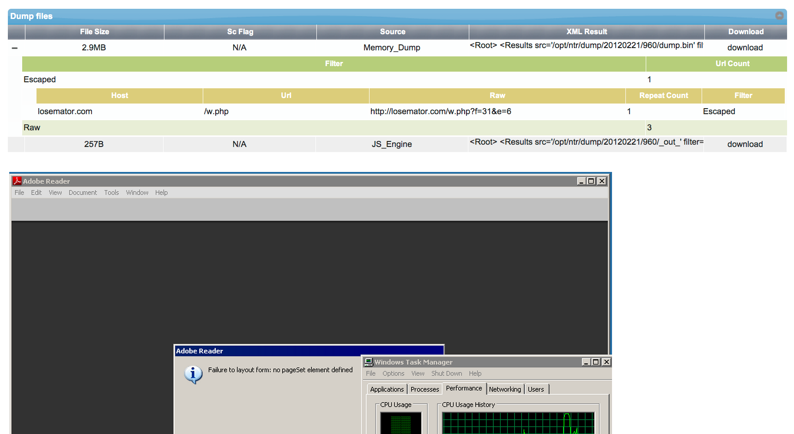
McAfee NTR: File Scan Server View

Slide 34
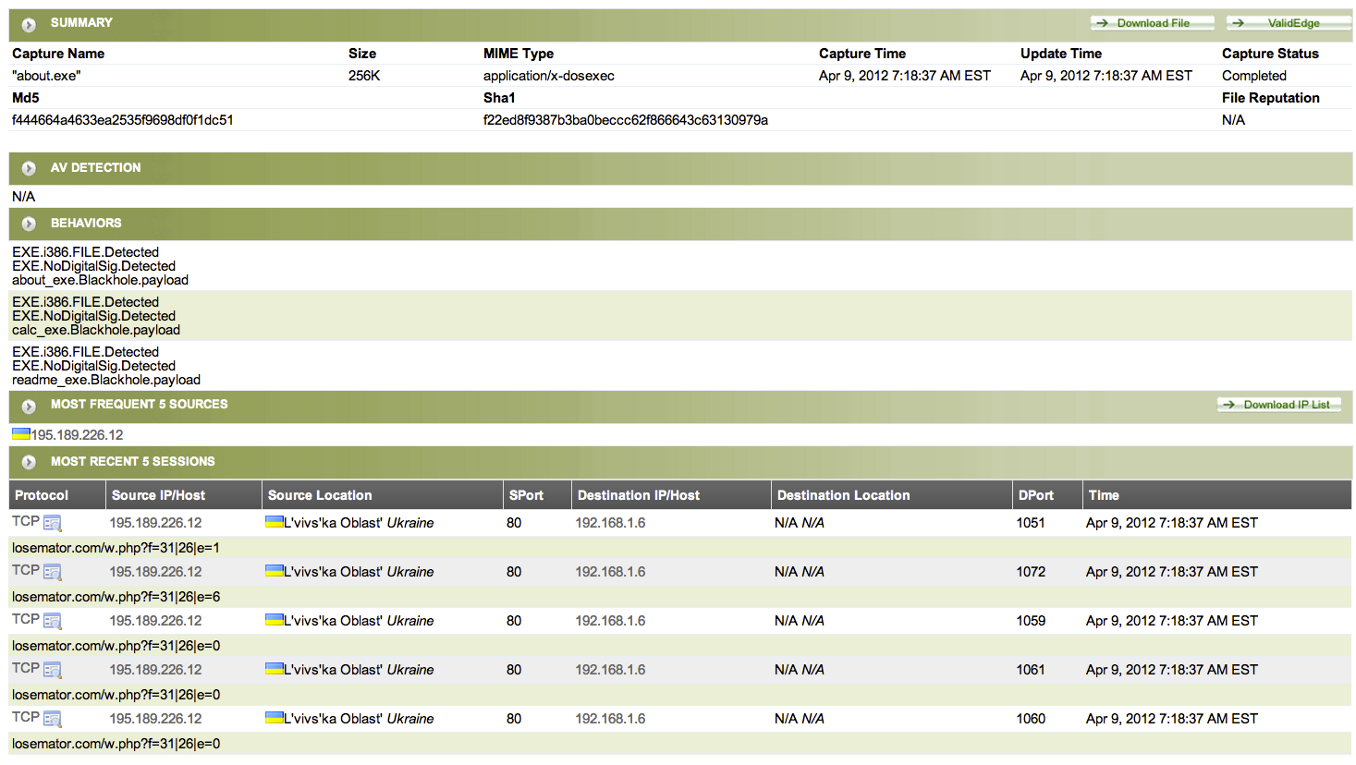
McAfee NTR: Drill Down on Exe View

Slide 35
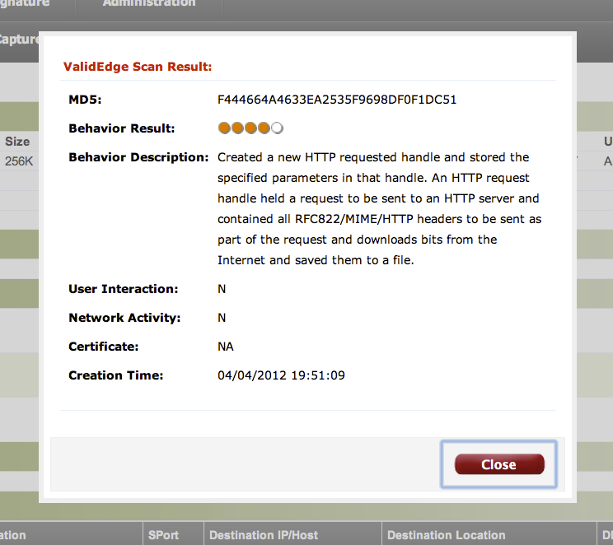
McAfee NTR: ValidEdge Result View

Slide 36
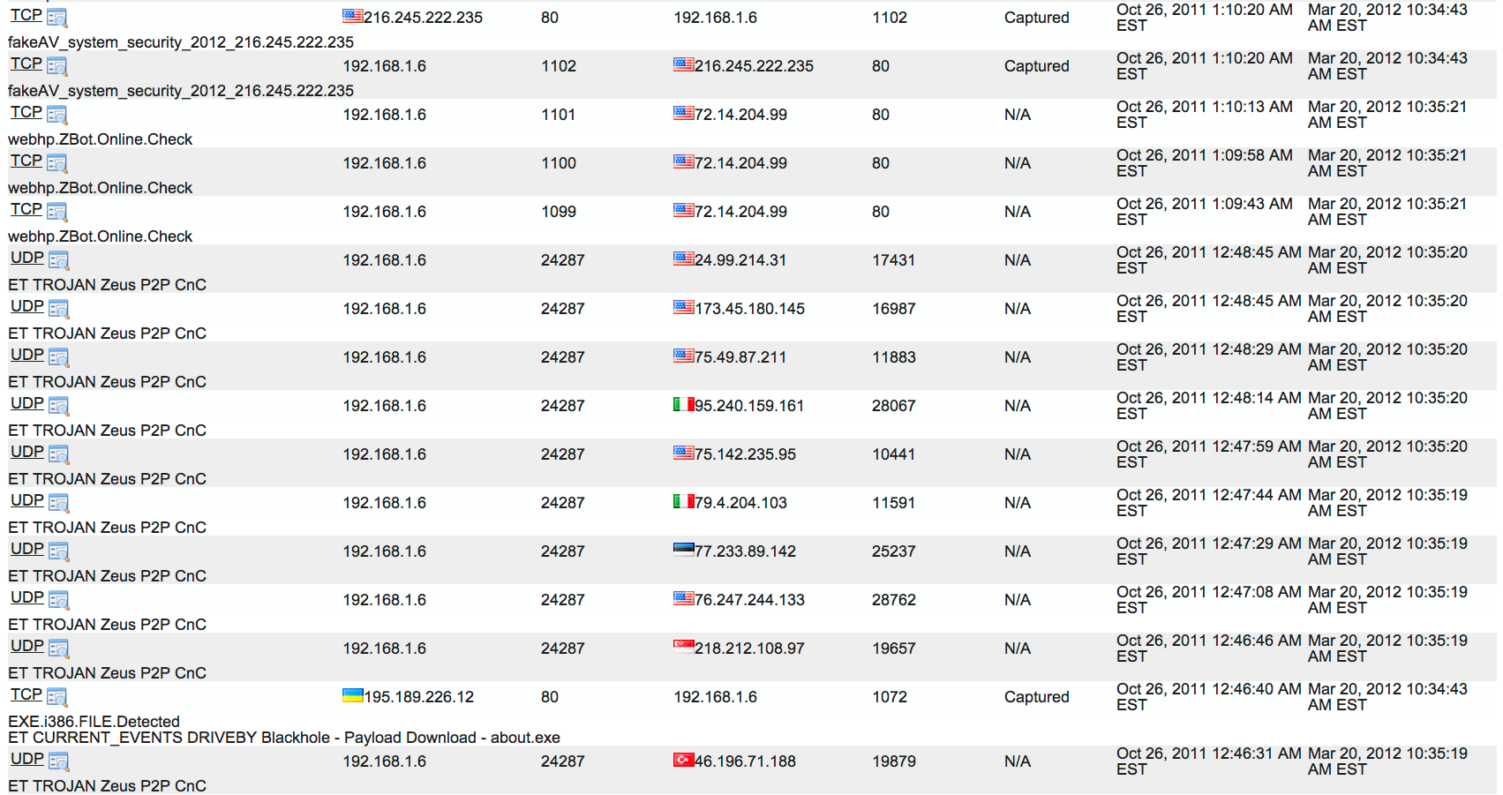
McAfee NTR: Alerts

Slide 37
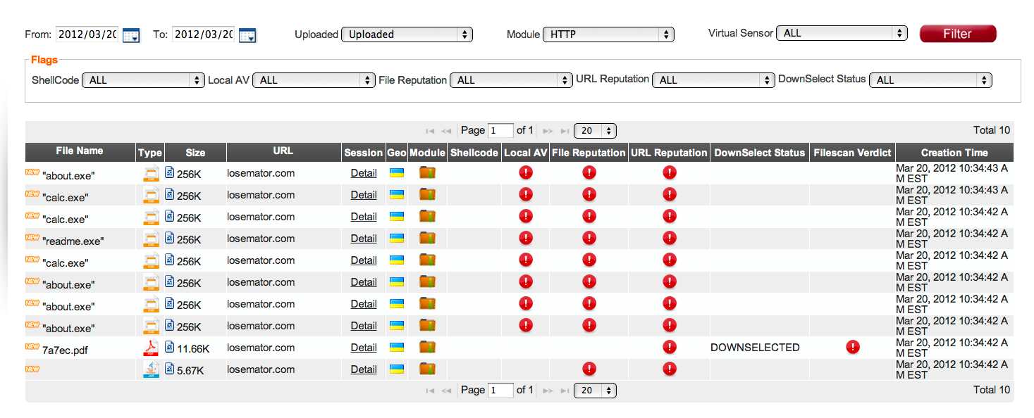
McAfee NTR: File Capture View

Slide 38
Use Cases

Slide 39
Use Case 1
Customer implemented two NTR sensors
McAfee began performing baseline period on Nov 18, 2011
APT monitoring service of NTR sensors started Dec 4, 2011
Results since Dec 4, 2011
  McAfee APT Services has screened approximately 36,262 indicators of suspected malicious activity
  McAfee APT services has produced 47 incident reports all leading to remediation by the customer
Majority of threats are Java related

Slide 40




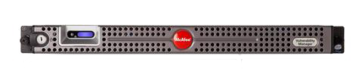
Attack Scenario
1
User Visits Unknown Website
User re-directed to suspicious web server
2
Malicious Java applet
Sent to end user
NTR detects behavior of the malicious re-direct s and captures malware dropper including Java applet and PDF.
These different packets are sent to CADS for malware analysis and deconstruction.

Slide 41
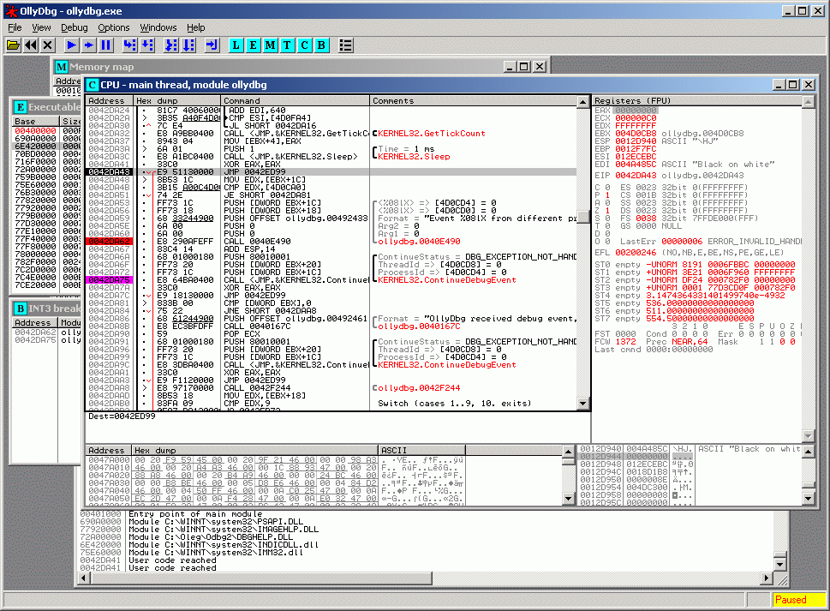
Attack Scenario Continued
When the machine downloaded the JAR and
PDF, these files took advantage of vulnerabilities in Java and
Adobe which forced the download of an executable.
3
NTR captures the downloaded executable and sends it to CADS for where multiple sandboxes, AV Server farms, and other back end analysis engines are used.
An analyst is alerted with an actionable event that he can respond to.
NTR is updated based on analysis of changing threats.

Slide 42
APT Incidents Reported
Total incidents by severity level reported via APT monitoring service since December 4th 2011

Slide 43
Value Added
As a result of the NTR deployment:
The customer has cleaned or re-imaged multiple hosts
New signatures were written to protect customer environment
After exposing Java vulnerabilities, the customer plans to modify patching procedures
  Customer enterprise has remained at Java 6, Update 23 due to a small number of hosts which requires the earlier version of Java to run legacy software.
  Rather than leave enterprise at risk, customer will upgrade all hosts to Java 6, Update 31
After exposing Internet Explorer vulnerabilities, the customer plans to upgrade from IE 6 to latest version IE 8.

Slide 44
שאלות ?

