Slide 1
The Mechanical Cryptographer (Tolerant Algebraic Side-Channel Attacks using pseudo-Boolean Solvers)
Yossi Oren
Technion Crypto Day, July 2012
Joint work with Mathieu Renauld, François-Xavier Standaert and Avishai Wool
Notes:
Only non-doctor, talk a bit different Only one equation on slide 18
Hand raising – transistor? Flip flop (not shoes)? AES? Touched a scope?

Slide 2
Plaintext
AES
Key
Ciphertext
Why is this so hard?
Notes:
AES is a well known block cipher – 256 bits in, 128 bits out. What’s inside? Simple bit operations. Anything else goes in? No quantum, no randomness, no pixie dust
Very fast - modern CPUs can do trillions of AES operations per second

Slide 3
So why are block ciphers secure?
The ciphertext is a function of the plaintext and the key
The plaintext is a function of the ciphertext and the key
The key is a function of the plaintext and the ciphertext
Where’s the catch?
P
AES
K
C
Notes:
Key is not necessarily one-to-one and onto. We can restrict or use multiple pairs of P+C

Slide 4
So why are block ciphers secure?
The ciphertext is an efficiently representable function of the plaintext and the key
The key cannot be efficiently represented as a function of the plaintext and the ciphertext
Inefficiently representable functions take either a huge space or a long time to evaluate
Notes:
The reason – diffusion (who does it? ShiftRows+MixColumns), round structure
Time-memory tradeoff Hellman
What is an efficient representation? Small program that takes a short time to run

Slide 5
Set of m logical statements over n variables x₁, …,x_{n}
Solver
Satisfying assignment (or proof of unsatisfiability)
Notes:
Solvers are used in e.g. circuit verification, schedule planning, route planning
Example constraints: somebody has to give this class, a track can’t have two trains, interns need at least 6 hours of sleep per night, Dr. Cohen doesn’t work on Saturdays.

Slide 6
Cryptanalysis with Solvers
Idea: Use solvers to perform cryptanalysis [MM ‘00]:
Given a description of a crypto algorithm and a set of plaintext and ciphertext pairs, find the cryptographic key
Result: Modern crypto is strong enough to resist solvers
Massacci and Marraro, Journal of Automated Reasoning 2000
Notes:
Resist solvers – the solving time is impractical
How solvers work – try a partial hypothesis, see if it works well add more variables, etc etc

Slide 7
From Cryptanalysis to Power Analysis
Plaintext
Cryptanalysis: Given a description of a cryptographic algorithm and a set of plaintext and ciphertext pairs, find the cryptographic key
AES
Key
Ciphertext
Notes:
If the problem is hard, so engineers redefine the problem

Slide 8
Plaintext
AES Device
AES
Key
Power Trace
Ciphertext
Notes:
What’s nice about the traces – low diffusion

Slide 9
From Cryptanalysis to Power Analysis
Plaintext
Power Analysis: Given a description of a crypto device, plaintexts, ciphertexts and a set of power traces, find the cryptographic key
AES Device
AES
Key
Power Trace
Ciphertext
Notes:
Classical power analysis uses statistical methods with high data complexity. Very interesting but not covered here. Today we’ll talk about a low data complexity method.

Slide 10
Theory of power analysis
Power consumption is variable
Different instructions ⇒ different power consumption
Different data ⇒ different power consumption
Analysing power consumption ⇒ learn about instructions and data
Reverse Engineering
Key Recovery
Notes:
Various ways of doing this: simple power analysis (e.g. for branching), DPA

Slide 11
Power Consumption is Variable?
Photo credit: Sergey Peterman, http://sergeypeterman.com/en/portfolio/objects.html
Notes:
Used to be hard to believe before cellphones
Phone gets warmer, battery runs down
Why? Capacitors and transistors come from the physical form of the circuit

Slide 12
Side-Channel Analysis with Solvers
Idea: Use solvers to perform side-channel analysis [PRR+ ’07 & RSV-C‘09]
Result: key can be recovered from side channel data if there are no errors in the side-channel trace
but…
Potlapally, Raghunathan, Ravi, Jha, Lee
IEEE Trans. VLSI 2007
Renauld, Standaert, Veyrat-Charvillon CHES 2009

Slide 13
The Harsh Reality of Power Analysis
V_{dd}
Electronic Noise
P1
C1
a
Output
Switching Noise
C2
N1
Power Trace
A
GND
Measurement Noise
Notes:
We process the power trace to create the formulas
We need to recover trace precisely
Noise adds imprecision

Slide 14
The Information-Robustness Tradeoff

Slide 15
Measurement Space
Precise measurement
Actual measurement
Source: NASA / The Hubble Heritage Team / STScI / AURA
Notes:
Each axis is a different leak – we typ. Have hundreds
This is not the key – it’s the precise measurement

Slide 16
The Harsh Reality of Power Analysis
The side channel traces have errors
Equation set with errors causes unsatisfiability
Compensating for errors causes intractability
Notes:
“too much errors”
If the problem is hard, so engineers redefine the problem

Slide 17
From solvers to optimizers
Goal function
Set of m logical statements over n variables x₁, …,x_{n}
Solver
Optimizer
Satisfying assignment
Optimal
Basic idea: Some mistakes are more expensive than others
In our context: Given a description of a crypto device, plaintexts, ciphertexts and a set of power traces, find the cryptographic key that minimizes the estimated error
Notes:
Optimizers are much slower than solvers
Introduce soft decoding – I can give a concrete “price” to every mistake I make, based on aposteriori probabilities

Slide 18
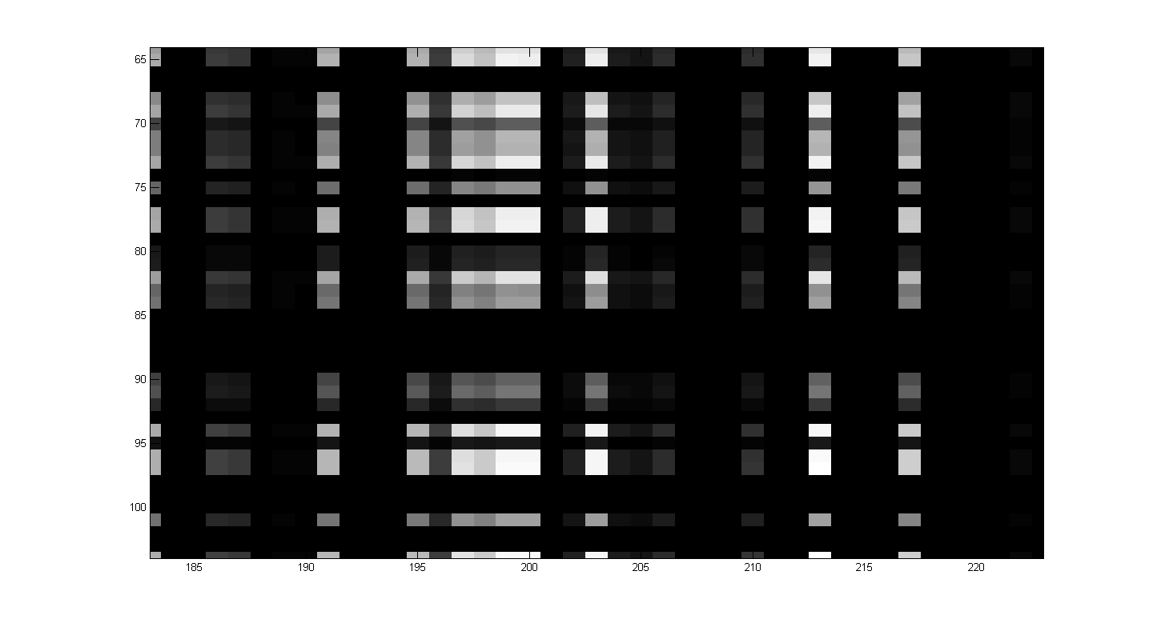
Measurement Space
Point is #680 most probable out of 65,536
Notes:
Uniform shape - iid

Slide 19
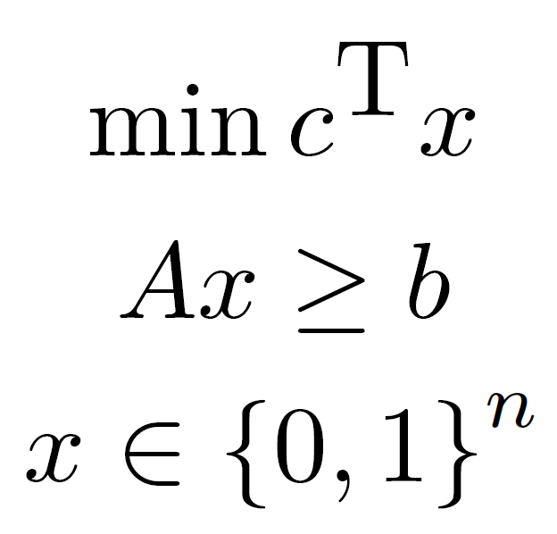
Pseudo-Boolean Optimizers
Linear PBOPT:
(all coefficients are signed integers)
Non-linear PBOPT allows NL constraints

Slide 20
Sample OPB Instance
min: x1 +3 x2 + x3 ;
x1 +2 x2 + x3 >= 2 ;
Notes:
Pseudo-Boolean – variables are 0/1 but they accept algebraic operations

Slide 21
PBOPT is Great for Side-Channels
The variables (=flipflops) are pseudo-Boolean
The constraints(=measurements) are integers
NL notation rich enough to represent arbitrary functions (such as XORs)
NOR: -out + ~x₁~x₂ = 0
XOR: -out + x₁ + x₂ -2 x₁x₂ = 0
Keeloq NLF: -~out +x₁x₅ -x₅ -x₁x₃ -x₂x₃ -x₄ +x₂x₅ +x₃x₄ +x₄x₅ +x₁x₂x₃ +x₁x₂x₄ -2x₁x₂x₅ +x₁x₃x₅ -x₁x₄x₅ = -1

Slide 22
PBOPT has a good goal function
Max product of aposteriori probabilities becomes min sum of log probabilities:
min: +6 x_is_00 +10 x_is_01 +24 x_is_02 +24 x_is_03;
+1 ˜ x_is_00 +1 ˜ x0 ˜ x1 ˜ x2 ˜ x3 ˜ x4 ˜ x5 ˜ x6 ˜ x7 = 1;
+1 ˜ x_is_01 +1 x0 ˜ x1 ˜ x2 ˜ x3 ˜ x4 ˜ x5 ˜ x6 ˜ x7 = 1;
+1 ˜ x_is_02 +1 ˜ x0 x1 ˜ x2 ˜ x3 ˜ x4 ˜ x5 ˜ x6 ˜ x7 = 1;
+1 ˜ x_is_03 +1 x0 x1 ˜ x2 ˜ x3 ˜ x4 ˜ x5 ˜ x6 ˜ x7 = 1;
+1 x_is_00 +1 x_is_01 +1 x_is_02 +1 x_is_03 = 1;

Slide 23
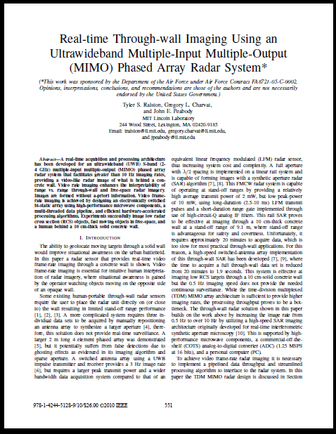
The TASCA Workflow
DUT
Reverse Eng.
Power Model
Traces
Aposteriori Probs.
Optimizer
Decoder
Secret Key

Slide 24
An Attack on AES
Solver: SCIP
Cryptosystem: AES-128 on 8-bit platform
Number of measurements: 100
Noise SNR: approx. 10dB
Median solving time: 342 seconds
Key recovery success rate: 100%
Notes:
In CHES 2010 we discussed an attack on Keeloq

Slide 25
Conclusions
Using optimizers, crypto devices can be attacked with very low data complexity
Any leak can be used, as long as a “soft decoder” exists for it
This calls into question the security of previously “safe” devices
Notes:
Decoders – template based, Naïve Bayes, etc
Leakage models – what if we don’t use HW but a more sensitive model (e.g. bus accesses etc)

Slide 26
Future Work
Investigate different decoders
Investigate different leakage models
Establish limits for data/computation tradeoffs for successful key extraction
Notes:
Decoders – template based, Naïve Bayes, etc
Leakage models – what if we don’t use HW but a more sensitive model (e.g. bus accesses etc)

Slide 27
Thank you!
http://iss.oy.ne.ro/Template-TASCA

