Slide 1
New Advances in Garbling Circuits
Benny Applebaum
Tel Aviv University
Based on joint works with
Yuval Ishai Eyal Kushilevitz Brent Waters
Technion
Technion
University of Texas

Slide 2
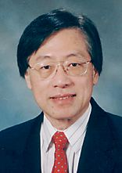
Garbled Circuit
“Encryption of a function”
Yao, 80’s
Notes:
Is a remarkably powerful cryptographic technique that has many different applications in cryptography and elsewhere.
It even has its own garbled wikipedia entry, which has the extra security feature that it resists a powerful cryptanalytic attack known as “Google Translate”.

Slide 3
Garbled Circuit Construction
Boolean circuit C
Garbled circuit C’
C’
0110101101010011
1111010100101111
1101010100111010
1001011001010110
0110111010010011
1111100101101110
0101100111011011
0001101010110111
1110101010100110
01101101010011001
0111010100101111
10111010100100111
0101010011111011
01010100110111011
1001001010110111
10010101010010111
x₁
x₂
x₃
x₄
K_{1,0}
K_{2,0}
K_{3,0}
K_{4,0}
“Simple & Short”
Input X
K_{1,1}
K_{2,1}
K_{3,1}
K_{4,1}
Pairs of short keys
Can be based on any pseudorandom generator [BM82,Yao82] (or one-way function [HILL90])
$$C\left(x\right) C^{′}, K_{i,x_{i}}$$
decoder
simulator
Notes:
Ki,xi will be abbreviated by K_{x}
The key features (and the miracle) are: (1) simple dependence of inputs; (2) short keys

Slide 4
Applications
Constant-round secure computation [Yao82,BMR90...]
Related to: computing on encrypted data [SYY99]
Alternative technique: FHE [Gentry09,…]
Parallel cryptography [AIK05]
One-time programs [GKR08]
Verifiable computation [GGP10,…]
KDM-secure encryption [BHHI10,...]
Functional Encryption [SS10,…]

Slide 5
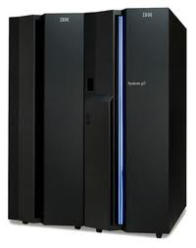
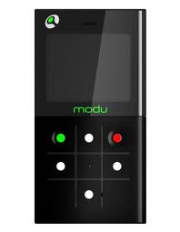
Non-Interactive Delegation
offline: C’
online: K_{x}
x
C(x)
Notes:
Uses another feature of the construction: small sequential online complexity. We can compute the garbled circuit and the keys offline, and only select the (short) keys online.
Suppose you go out to the field with your modu phone, and you realize you forgot the super-computer jacket at home.
We don’t know of any alternative approach, even using FHE, random oracles, PCPs.

Slide 6
Yao’s Construction
Each wire w has 0-key and 1-key
Colored “blue” and “green” at random
w
w
1-key
0-key
Notes:
Use a random color code

Slide 7
Yao’s Construction
Each wire w has 0-key and 1-key
Colored “blue” and “green” at random
K_{i,b}= b-key of input wire i
C’ = color code for output wires
+ “garbled gates”
w
w
1-key
0-key
0
0110101101010011
1111010100101111
1101010100111010
1001011001010110
0
0110111010010011
1111100101101110
0101100111011011
0001101010110111
0
1
1110101010100110
01101101010011001
0111010100101111
10111010100100111
0101010011111011
01010100110111011
1001001010110111
10010101010010111
0
1
0
0
Notes:
Use a random color code

Slide 8
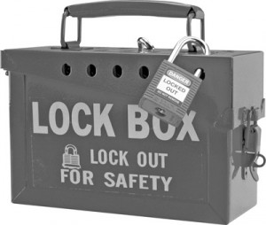
Garbled Gates
a
b
c
c
a
b
c
a
b
c
a
b
a
b
c
Notes:
A garbled gate consists of 4 ciphertexts, each encrypting the right output key with the right pair of input keys. Note that if we could look inside all 4 boxes then we could reveal c.

Slide 9
Post-Yao Constructions ?
A lot of progress wrt implementation
E.g., Fair-Play [MNPS04] …
Better concrete efficiency
Free XOR gates [KS08]…
3 ciphertexts per gate [PSSW09]
Little theoretical progress
Info-theoretic variants for restricted classes [IK00-2]
Rerandomizable GC [GHV10]
No asymptotic improvements !
Notes:
The way we view GC today is very close to the way Yao described them 30 years ago!

Slide 10
Abstraction (Randomized Encoding [IK00])
0110101101010011
1111010100101111
1101010100111010
1001011001010110
Garbled circuit C’
(public)
Boolean circuit C
0110111010010011
1111100101101110
0101100111011011
Random
0001101010110111
Random
1110101010100110
01101101010011001
0111010100101111
10111010100100111
0101010011111011
01010100110111011
1001001010110111
10010101010010111
x₁
x₂
x₃
x₄
K_{1,0}
K_{2,0}
K_{3,0}
K_{4,0}
Garbled
Input X’
Input X
K_{1,1}
K_{2,1}
K_{3,1}
K_{4,1}
Decoder
C(X) C’, X’
Simulator
Notes:
Ki,xi will be abbreviated by K_{x}
The key features are: (1) simple dependence of inputs; (2) short keys

Slide 11
Abstraction (Randomized Encoding [IK00])
Q1: Can we shorten the garbled input X’?
Q2: Can we garble arithmetic circuits?
Garbled circuit C’
(public)
Boolean circuit C
Random
n bits
“Simple”
Decomposable Affine
K₁(X₁) … K_{n}(X_{n})
where K_{i} is affine over F₂
Garbled
Input X’
“Short”
λn bits
Input X

Slide 12
How short can X’ be? [AIKW12]
Constant Online-Rate?
Thm. Impossible if X’ is decomposable
Observation: Typically Affinity suffices
Thm. Affine GC with online-rate 1 under DDH, RSA, LWE.
O(n) + λ?
n + λ [This work]
n bits
“Simple”
Decomposable Affine
K₁(X₁) … K_{n}(X_{n})
where K_{i} is affine over F₂
Garbled
Input X’
“Short”
λn bits
Input X
X’
Affine
X’=K(X)
where K is affine
Notes:
HERE

Slide 13
Gadget: Online/Offline Encryption
Alice
Bob
M_{n} | M₄ | M₃ | M₂ | M₁
C_{n} | C₄ | C₃ | C₂ | C₁
M_{n} | C₄ | C₃ | M₂ | C₁
Enc_{K}
subset s⊆{1,…,n}
1 | 0 | 0 | 1 | 0
Key length = λ
Independent of the number of plaintexts
K_{S}

Slide 14
Gadget ⇒ Succinct GC
Simulator
C(x)
Garbled circuit C’
Garbled circuit C’
Boolean circuit C
Yao
Gadget
Input X
Random
Subset
K_{S}
Decoder
Notes:
Ki,xi will be abbreviated by K_{x}
The key features are: (1) simple dependence of inputs; (2) short keys

Slide 15
Implementing the Gadget
Tool: Symmetric Encryption with Additive Homomorphism for Keys/Message
E_{K1}(M₁)+…+E_{Kn}(M_{n}) = E_{K1+…+Kn}(M₁+…+M_{n})
One-Time Security suffices
Can be implemented under DDH
Close variants under LWE, RSA

Slide 16
From Homomorphism to Online/Offline Encryption
Alice
C₁ C₂ C₃ C₄
C₁+C₃
M₁
 | M₂
 |  | M₃
 |  |  | M₄
C₁
 | C₂
 |  | C₃
 |  |  | C₄
M₁
M₃
M_{n} | M₄ | M₃ | M₂ | M₁
C_{i}=Enc(K_{i},M_{i})
K_{S}
0 | 1 | 0 | 1

Slide 17
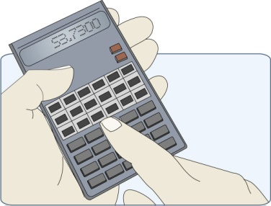
Application 1: Verifiable Computation
Optimal online complexity using [GGP10,AIK10]
Previous works: multiplicative overhead in λ
f:{0,1}^{n}→{0,1}^{m}
Untrusted Server
Weak Client
Offline λ|f| bits
x
n+λ bit
m+λ bit
output
Notes:
Unknown under FHE

Slide 18
Application 2: MPC with preprocessing
Semi-Honest MPC for f:{0,1}^{n}→{0,1}^{m}
Alice
Bob
A
b
B
f(A,B)
Notes:
Incomparable to FHE

Slide 19
Application 2: MPC with preprocessing
1 online round
Online Communication does not grow with m
Additive dependency in λ
Semi-Honest MPC for f:{0,1}^{n}→{0,1}^{m}
Alice
Bob
Garbled circuit C’
Offline λ|f| bits
r_{A}
r_{B}
r_{A}⊕ A
n bits
A
b
B
r_{B}⊕ B
n+λ bits
Decoder
f(A,B)
Notes:
Incomparable to FHE

Slide 20
Application 2: MPC with preprocessing
Malicious MPC ?
Adaptive choice of inputs ?
Homomorphic MACs [BDOZ11]
Alice
Bob
Garbled circuit C’
Offline λ|f| bits
r_{A}
r_{B}
n bits
A
b
B
n+λ bits
Decoder
f(A,B)
Notes:
Bendlin, I. Damg˚ard, C. Orlandi, and S. Zakarias.
HERE

Slide 21
Adaptive Choice of Inputs?
No succinct GC with adaptive security
Can be achieved with Random Oracle
Not needed in some applications
offline private inputs (Shares of signing key)
Independent online public inputs (Docs to be signed)

Slide 22
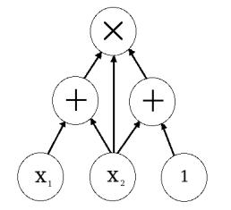
Garbling Arithmetic Circuits? [AIK11]
Gates perform addition or multiplication
Operations over a large domain (e.g., field F)

Slide 23
Garbling arithmetic circuits? [AIK11]
Thm. Arithmetic GC (over large integers) under LWE (or OWF less efficiently).
Extends applications to arithmetic setting
Non-trivial if the field is large !
Requires new approach
Garbled circuit C’
Arithmetic circuit C
Boolean circuit C
Random
“Simple”
Decomposable Affine
K₁(X₁) … K_{n}(X_{n})
K_{i} :F₂→F₂ is affine
Garbled
Input X’
Input X
λ
λ
K_{i}:F→F^{λ}
Notes:
Motivated by both efficiency and arithmetic feasibility

Slide 24
Garbling arithmetic formulas [IK02]
Problem 1: Limited to Formulas
Problem 2: Large blow-up
Key Idea: Solving 2 ⇒ Solving 1
Garbled circuit C’
Arithmetic Formula C
Boolean circuit C
Random
“Simple”
Decomposable Affine
K₁(X₁) … K_{n}(X_{n})
K_{i} :F₂→F₂ is affine
Garbled
Input X’
Input X
|C|²
λ
K_{i}:F→F^{λ}

Slide 25
Key-Shrinking Gadget
c
d
W
a
b
decoder
y
+
y
+
simulator
a,b,W can depend on c,d and randomness
Special type of “functional encryption”
Implementation over the integers from LWE

Slide 26
Garbling the Circuit Layer-by-Layer
AGC for C₁°…° C_{i-1}
C₁
…
…
…
…
…
C_{i-1}
a₁
b₁
+
y₁^{i-1}
y₂^{i-1}
y₃^{i-1}
y₄^{i-1}
y₁^{i-1}
…
x
+
x
x
W^{i-1}
y₁^{i}
y₂^{i}
y₃^{i}
y₄^{i}
C_{i+1}
…
…
…
…
…

Slide 27
Garbling the Circuit Layer-by-Layer
Substitution ➔
C₁
…
…
…
…
…
C_{i-1}
a₁
b₁
+
y₁^{i-1}
y₂^{i-1}
y₃^{i-1}
y₄^{i-1}
y₁^{i}y₂^{i}
…
x
+
x
x
W^{i-1}
y₁^{i}
y₂^{i}
y₃^{i}
y₄^{i}
C_{i+1}
…
…
…
…
…

Slide 28
Garbling the Circuit Layer-by-Layer
Affinization [IK02] ➔
C₁
c₁
d₁
c₂
d₂
…
…
…
…
…
C_{i-1}
+
+
y₁^{i-1}
y₂^{i-1}
y₃^{i-1}
y₄^{i-1}
y₁^{i}
y₂^{i}
…
x
+
x
x
W^{i-1}
y₁^{i}
y₂^{i}
y₃^{i}
y₄^{i}
C_{i+1}
…
…
…
…
…

Slide 29
Garbling the Circuit Layer-by-Layer
C₁
Key shrinking ➔
…
…
…
…
…
C_{i-1}
a₁
b₁
a₂
b₂
+
+
y₁^{i-1}
y₂^{i-1}
y₃^{i-1}
y₄^{i-1}
y₁^{i}
y₂^{i}
…
x
+
x
x
W^{i}
y₁^{i}
y₂^{i}
y₃^{i}
y₄^{i}
C_{i+1}
…
…
…
…
…

Slide 30
Conclusion
GC with optimal online-rate for Boolean circuits
Applications with optimal online communication
General approach for arithmetic garbled circuits
Alternative to Yao’s “garbled tables” approach
Instantiated using LWE
Extends applications to arithmetic setting
New modular, simplified proof for Boolean case
Constant online-rate for arithmetic formulas

Slide 31
Open Questions
Arithmetic setting
circuits over finite fields?
arithmetic decoder?
Efficiency
Shorten the offline part? |C’|=O(|C|)?
Can get it for natural class of arithmetic functions
Less computational overhead ? (online/offline)

Slide 32
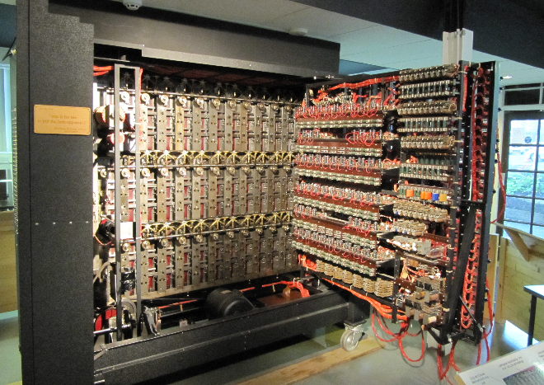
Take-Home Message: What are Garble Circuits?
Just
It
Powerful tool superior
to FHE in some aspects
(Asymptotically & Concretely)
FHE for the poor

